Slide 1



CAP-5610 Machine Learning
Spring 2021
Check Point 2 Presentation
Group Number 23
Group Members
Daoyang Song
Fatima Nasir
Marcus Figaro
Nidhi Devi

Slide 2
Breast cancer diagnosis based on feature extraction
using hybrid of K-means
And support vector machine algorithms
Authors:
Bichen Zheng, Won Yoon , Sarah S. Lam
Publication: Expert Systems with Applications: An International Journal , March 2014

Slide 3
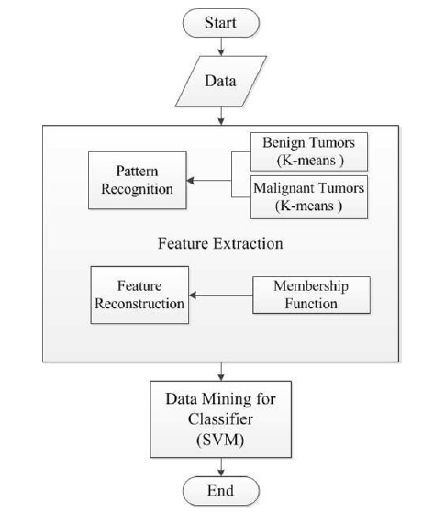

The paper proposed hybridized K-means and SVM (K-SVM) for breast cancer diagnosis.
Feature Extraction: Recursive Feature Elimination
KNN - Fatima Nasir
Naive Bayes - Marcus Figaro
Logistic Regression - Nidhi Devi
Random Forest/Decision Trees - Daoyang Song
ML Methods Implemented

Slide 4
KNN
Introduction
KNN is a supervised ML algorithm that can find very complex patterns and easy to interpret.
SVM and KNN both are widely used for classification , so it’s a good classifier to compare with.
KNN algorithm is a good choice for this small cancer dataset and the data is noise free and labeled as well so KNN is expected to perform good.
Implementation
KNN is implemented using scikit-learn ‘KneighborsClassifier’.
Grid search is used to find best hyperparameters including number of neighbors and distance metrics options.
KNN is applied to original dataset and dataset with reduced features.

Slide 5
RESULTS
Metrics | Original Features | Reduced Features
Number of Features | 30 | 6
Number of neighbors | 10 | 7
Training Time | 0.0621 | 0.00150
Accuracy | 95% | 87%
F1-score | 0.94 | 0.86

Slide 6
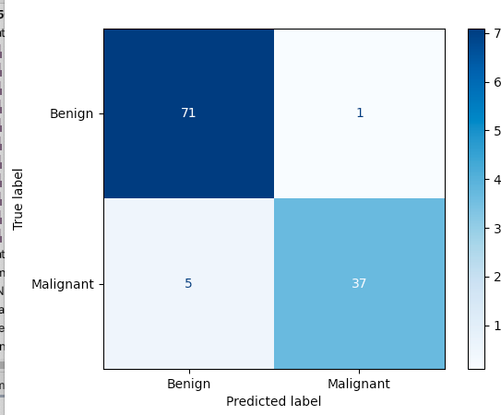
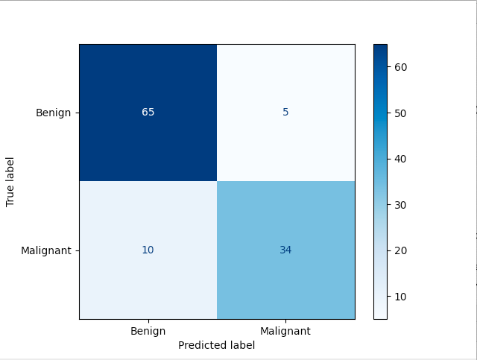
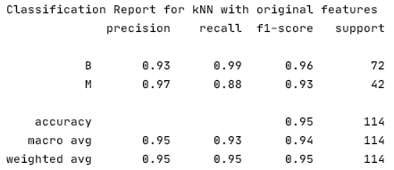
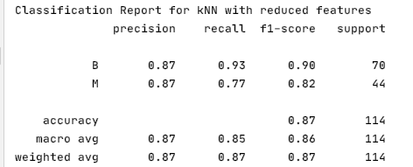
COMPARISON-CONFUSION MATRIX
K
N
N
k-KNN
KNN

Slide 7
COMPARISON
Observations
KNN has higher accuracy than k-SVM.
KNN when implemented with a same pipeline even has a reduced accuracy.
Computational time is small when reduced features are used.
KNN does not respond well with a reduced set of features.
Metrics | k-SVM | KNN | k-KNN
Number of features | 6 | 30 | 6
Training Time | 0.00406 | 0.0621 | 0.00150
Test Accuracy | 91% | 95% | 86.8%

Slide 8
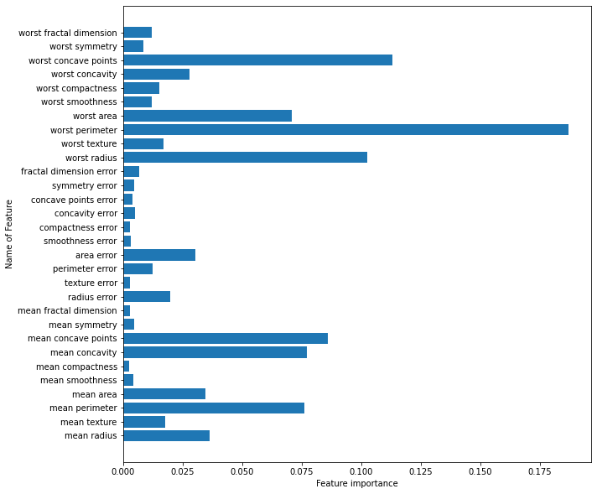
Improved Feature Extraction Method
Used Recursive Feature Elimination with Cross-Validation (RFECV)
RFECV uses random forest model for feature importance and CV to ensure the best selection of features.
It is an easy way to get rid of extra features without losing too much information.
Method: Recursive Feature Elimination starts by fitting a random forest classifier model on the entire set of features against the target data and computing an importance score for each predictor.
The weakest features are then removed, the model is re-fitted, and importance scores are computed again until it reaches the specified number of features.
RFECV combines RFE with cross-validation to score different feature subsets and select the best scoring collection of features to find the optimal number of features to use.

Slide 9
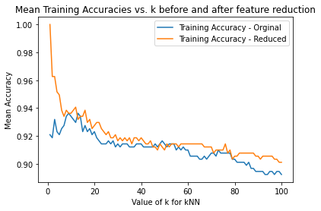
Improved Results
For this dataset 22 optimal features are selected out of 30 features.
The plot shows training accuracy is relatively less with reduced set of features.
Number of neighbors | 9
Training Time | 0.003777
Accuracy | 96.5%
F1 Score | 0.96

Slide 10
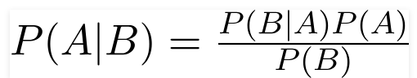
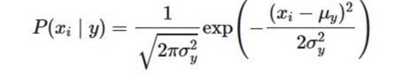

Naive Bayes Classification
The Naive Bayes probabilistic classification method is based on Bayes theorem:
Using Bayes theorem we can find the probability that A (The target variable) will occur given the probability of some attribute B.
Naive Bayes cannot be used with continuous data so we must assume the data follows a gaussian normal distribution in order to obtain probabilities of values occurring within the dataset.
Probability of features determined by the following equation:
Strengths:
Robust to noise and irrelevant attributes
Weaknesses:
Assumes that all features are independent of one another
Assumes that all features have an equal effect on the outcome

Slide 11
Naive Bayes Implementation and Results
We applied Naive Bayes to both the original dataset and the reduced dataset using Recursive Feature Elimination
Naive Bayes was implemented using the sci-kit learn library
Using Naive Bayes on both the original dataset and reduced feature set obtained higher accuracies than the K-SVM method.
 | Accuracy | Training Time
Original Dataset | 93.86% | 0.00188 s
Reduced Feature Set | 95.61% | 0.00169 s

Slide 12
Logistic Regression
Logistic regression is named on the function which is used at the core of the method, the logistic function also called the sigmoid function, was developed by statisticians to describe properties of population growth in ecology, rising quickly and maxing out at the carrying capacity of the environment.
1 / (1 + e^-value)
Where e is the Euler’s number or the EXP() function and value is the actual numerical value that you want to transform. In the range of 0 to 1.
Logistic regression is a statistical model that in its basic for uses a logistic function to model a binary dependent variable, although many more complex extensions exist.
Strength: Robust Model and practical usage is more, hence widely used.
Weakness: It leads to overfitting when number of observations is lesser than the number of features.

Slide 13
Logistic Regression Implementation and Results
We have applied Logistic regression in original dataset, the implementation of Logistic Regression is based on:
sci-kit learn - Linear_model by importing LinearRegression library
The accuracy with original and reduced dataset is given below:
Observation: Results show the accuracy is better with original dataset with linear regression and this accuracy is better than K-SVM.
 | Accuracy | Training Time
Original Dataset | 94% | 0.0106
Reduced Dataset | 93.8% | 0.0189

Slide 14
Decision Trees
Decision tree is a flowchart structure in which each internal node represents a "test" on an attribute. It is commonly used in operations research and operations management. If decisions have to be made online with no recall under incomplete knowledge, a decision tree should be paralleled with a probability model as a best choice model or online selection model algorithm.
Strength:
It’s simple to understand and utilize.
It can determine worst, best and expected values for different scenarios.
It can be combined with other decision techniques.
Weakness:
A small change in the data can lead to a large change in the structure
It’s often relatively inaccurate.
Its calculations can get very complex, particularly if many values are uncertain or the outputs are related.

Slide 15
Decision Trees Implementation and Results
We applied decision tree in original dataset, the implementation of decision tree is based on:
sci-kit learn – DecisionTreeClassifier by importing sklearn.tree
The accuracy with original and reduced dataset is given below:
 | Accuracy | Training time
Original dataset | 96.87 | 0.0046
Reduced dataset | 90.76 | 0.0027

Slide 16
Random Forest
Random forest is an ensemble learning method for classification, regression and other tasks that operates by constructing a multitude of decision trees at training time and outputting the class which is the mode of the classes (classification) or mean/average prediction (regression) of the individual trees.
Strength:
It is more accurate than a single decision tree.
It is flexible to both classification and regression problems
Weakness:
It requires much computational power as well as resources.
it also suffers interpretability and fails to determine the significance of each variable.

Slide 17
Random Forests Implementation and Results
We applied random forests in original dataset, the implementation of random forests is based on:
sci-kit learn – RandomForestClassifier by importing sklearn.ensemble
The accuracy with original and reduced dataset is given below:
 | Accuracy | Training time
Original data | 98.46 | 0.0109
Reduced data | 91.27 | 0.036

Slide 18
Comparison of Improved Methods
ML Method | Accuracy | Training Time
K-SVM | 91% | 0.00406
KNN | 96.5% | 0.003777
Naive Bayes | 93.86% | 0.00188
Logistic Regression | 94% | 0.092
Random Forest | 98.46 | 0.0109
Decision Trees | 96.87% | 0.0046
SVM | 95.61% | 1.247

Slide 19
Potential Issues
Data size is very small to apply deep learning techniques.
Using Feature extraction method(Recursive Feature Elimination with Cross-Validation (RFECV)) is not improving accuracy with all models - Specially if we see example of Logistic Regression. Original dataset have a better accuracy than reduced features.
RFECV based SVM is not very stable. With the range of 1 to 300, best regularization parameter will change for each run, the best kernel will also change for multiple runs.
Finding the best parameters took much longer for SVM than other methods.

